Slide 1

Level Devil: A Reinforcement Learning Challenge
A deceptive platformer environment for training & evaluating deep reinforcement learning agents, supporting both manual gameplay and PPO-based learning.

Slide 2
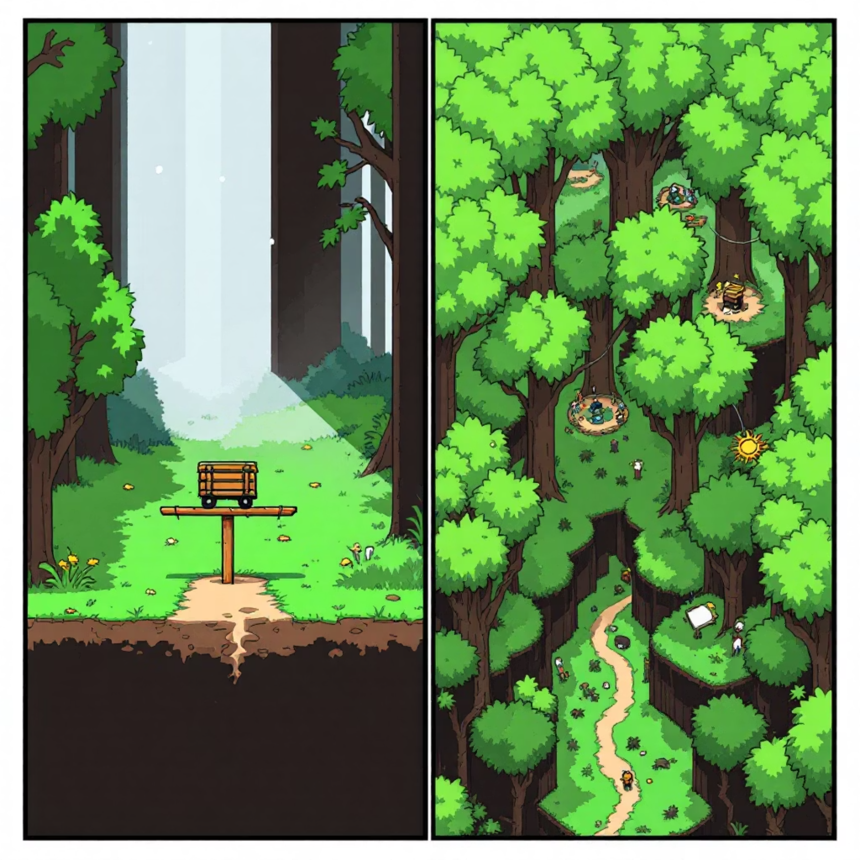
Motivation: Beyond Predictable Environments
Traditional RL Limitations
Standard environments like CartPole and MountainCar offer predictable dynamics that rarely reflect real-world complexity.
Sparse Rewards
Agents receive feedback rarely, making learning difficult
Deceptive States
Good-looking states that actually lead to failure
Temporal Traps
Bad consequences visible only after significant delay

Slide 3
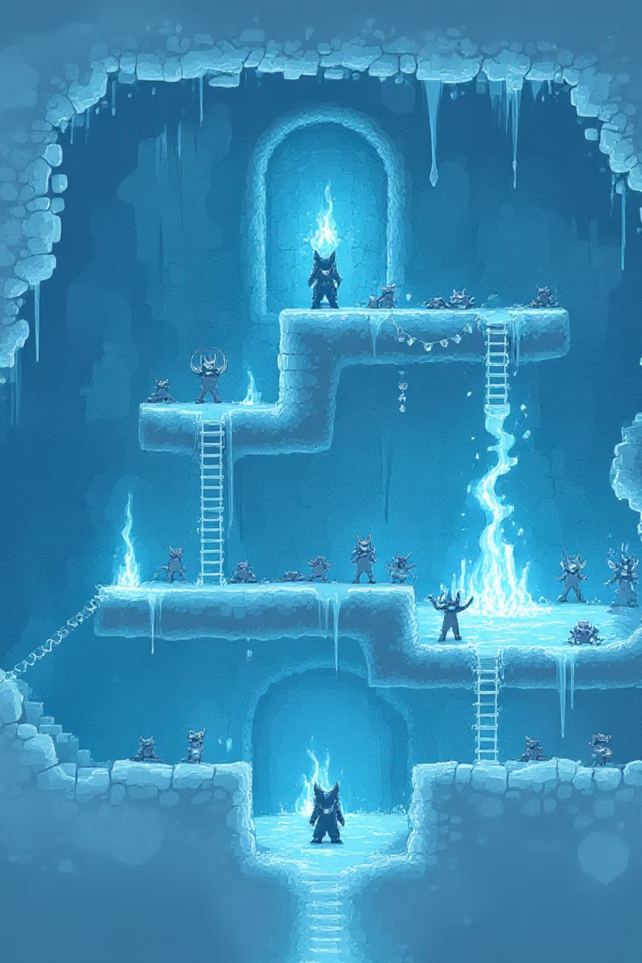
Architecture: Building the Deceptive Environment
Environment Implementation
gymnasium.Env subclass with Pygame-based renderer
RGB image observation space (160×120×3)
Discrete(4) action space: Left, Right, Jump, Stay
Agent Configuration
PPO (Proximal Policy Optimization) with CnnPolicy
DummyVecEnv + VecTransposeImage for frame compatibility
Experience generated purely through exploration

Slide 4
Experimental Design
Training Process
Key Metrics
20,000 timesteps across 10+ PPO iterations
ep_rew_mean: Average reward over recent episodes
Reward shaping: small reward for moving right
Survival bonus to encourage longer episodes
ep_len_mean: Average episode duration
Monitor for logging, Tensorboard for metrics
entropy_loss: Policy exploration adequacy
value_loss: Value network approximation quality
Human baseline established through manual play to identify misleading areas and compare learning strategies.

Slide 5
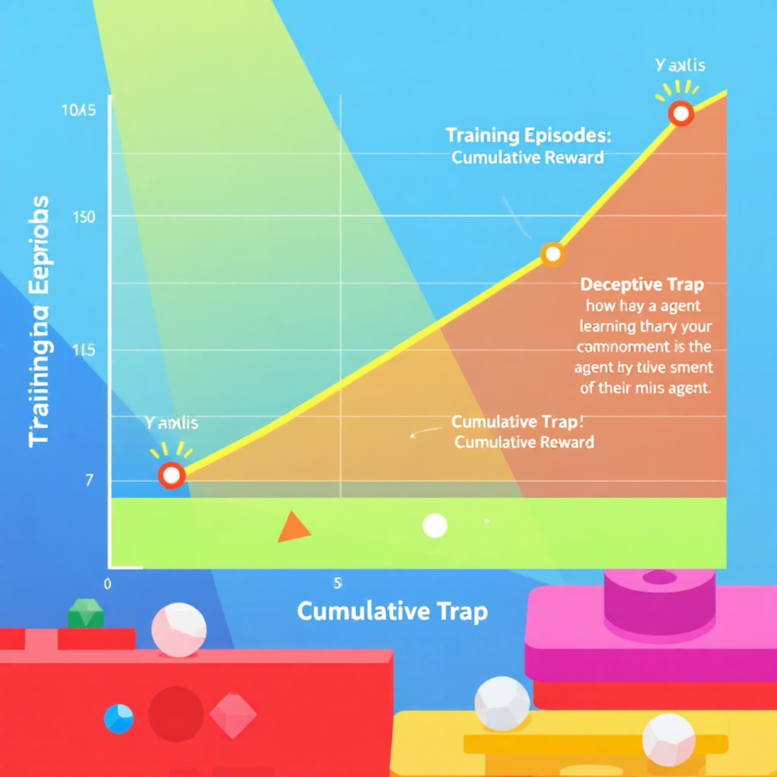
Results: Learning in a Deceptive World
Key Observations
PPO without shaping dies instantly (reward = -1)
With reward shaping: modest improvements in avoiding spikes and survival time
Agent learns danger not from visual appearance but from outcomes
Challenges
Low KL divergence: agent too cautious
Flat entropy indicating insufficient policy variance
Full mastery not achieved within 20k steps

Slide 6



Future Research Directions
Technical Improvements
Visualization Tools
Research Questions
PPO-LSTM or DRQN for partial observability
Trajectory heatmaps for death/safe zones
RL robustness in deceptive environments
Curriculum learning for incremental difficulty
Saliency maps showing CNN attention
Algorithm comparison: PPO vs SAC vs DQN
Enhanced reward signals (goal zone, memory)
Ghost replay comparing agent vs human
Generalization with shifting tile positions

Slide 7

Conclusion
Level Devil provides a high-stakes playground for reinforcement learning research that exposes limitations in current approaches to exploration when visual feedback is misleading.
Educational Value
Side-by-side comparison of manual and automated learning reveals key insights into decision-making processes.
Research Applications
Platform extensibility supports ongoing work in generalization, interpretability, and robust policy learning.
A practical case study for safe reinforcement learning, adversarial design, and behavior shaping in environments with misleading sensory information.

